Slide 1
Enabling the
Next Generation
of Collaboration
and document management

Slide 2



Yves Kerwyn ► yves.kerwyn@microsoft.com
Office & SharePoint Product Marketing Manager

Slide 3

The Best Productivity Experience Across the PC, Phone & Browser

Slide 4


Microsoft SharePoint 2010
>The Business Collaboration Platform for the Enterprise & the Web
Sites
Connect and Empower People
Composites
Communities
Cut Costs with a Unified Infrastructure
Insights
Content
Rapidly Respond to Business Needs
Search

Slide 5

Adoption Made Easier with Office Ribbon UI

Slide 6
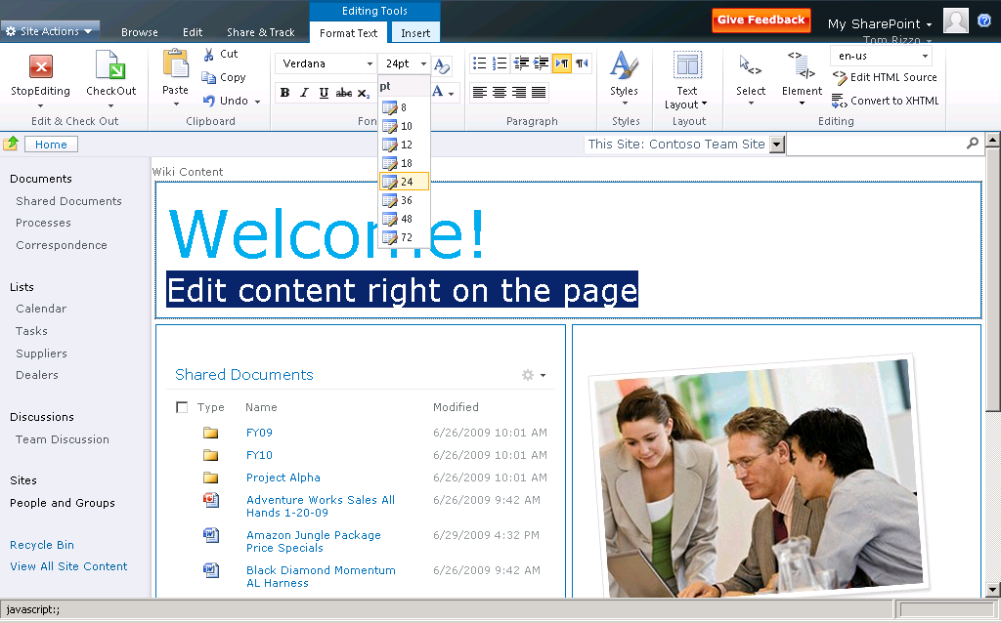
Web Edit

Slide 7
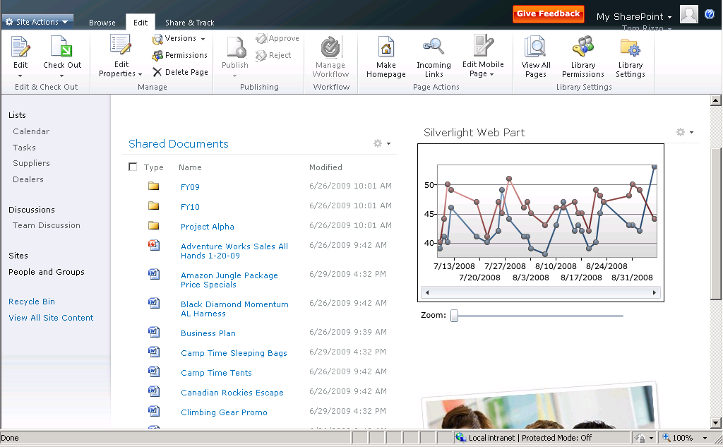
Rich Internet Applications
> Native Silverlight Support

Slide 8
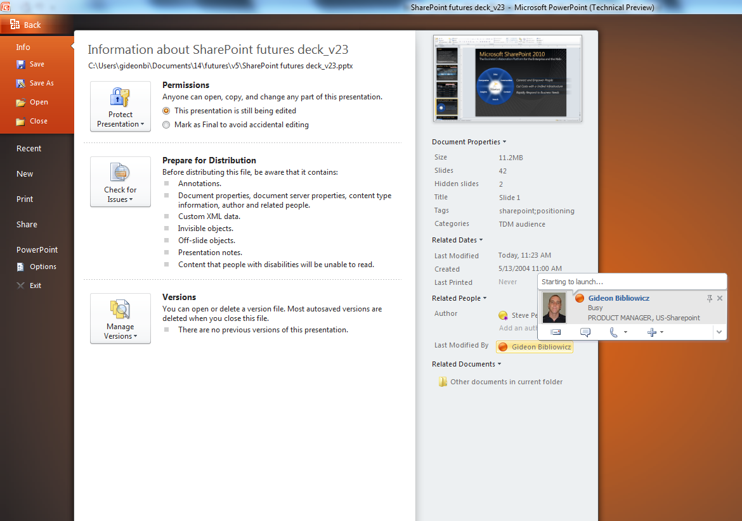
SharePoint Sites
> In-context Collaboration in the Office Backstage
Metadata capturing
Save to SharePoint
Share and
Collaborate
Authoring Context & Presence
Related Content
Pre-Beta screenshots, subject to change

Slide 9
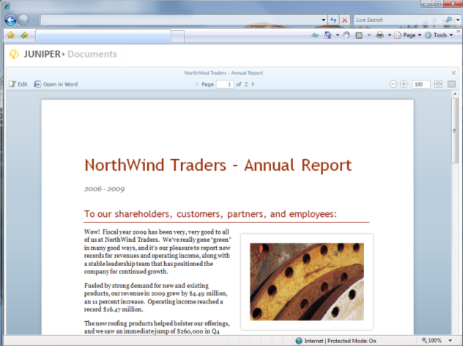
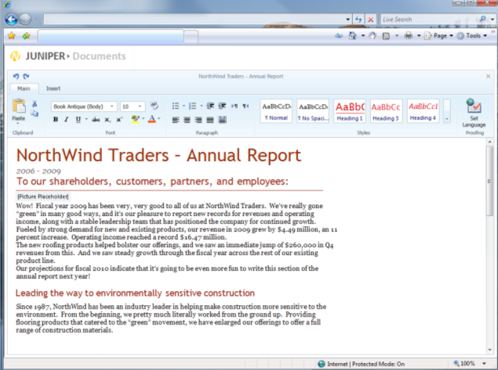

> Work Anywhere with the Office Web Applications
SharePoint Sites
Office Word, Excel, PowerPoint, OneNote web applications
Familiar Ribbon User Interface
High-fidelity viewing experience
Essential editing with no formatting or data loss
Viewing
Editing
Pre-Beta screenshots, subject to change

Slide 10
SharePoint Sites
> Easier Localization with Multi-lingual User Interface
Switch in run-time between languages
Pre-Beta screenshots, subject to change

Slide 11
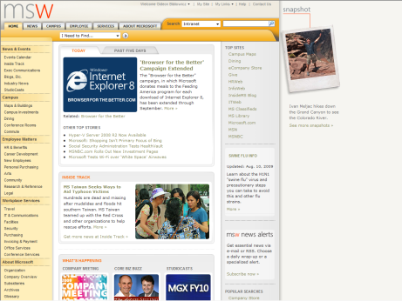
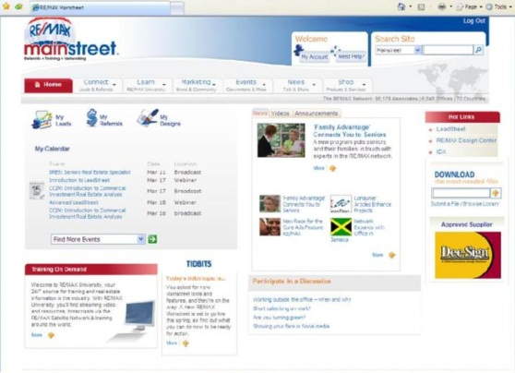
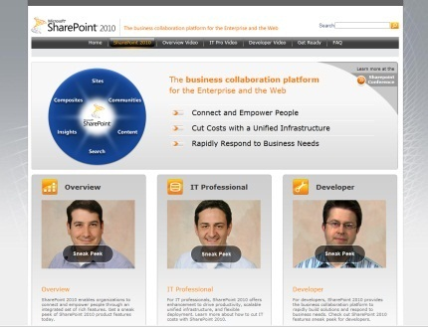
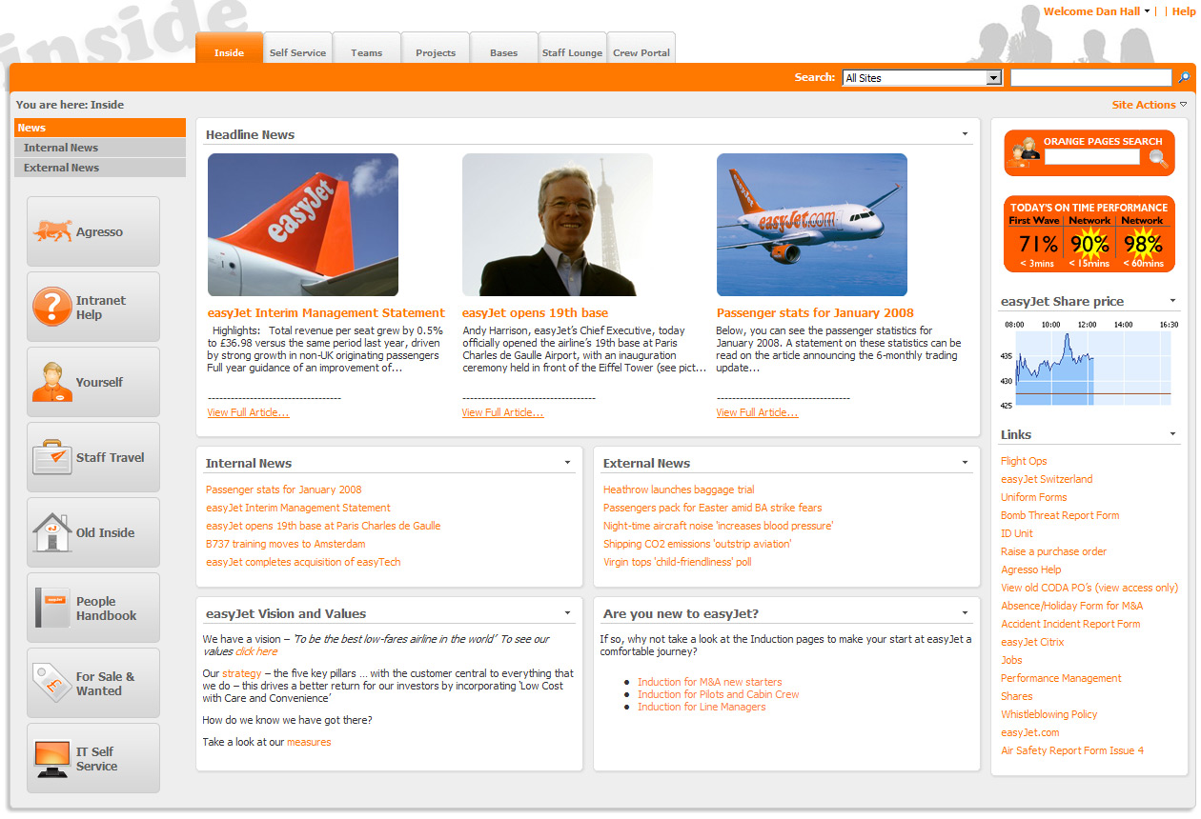
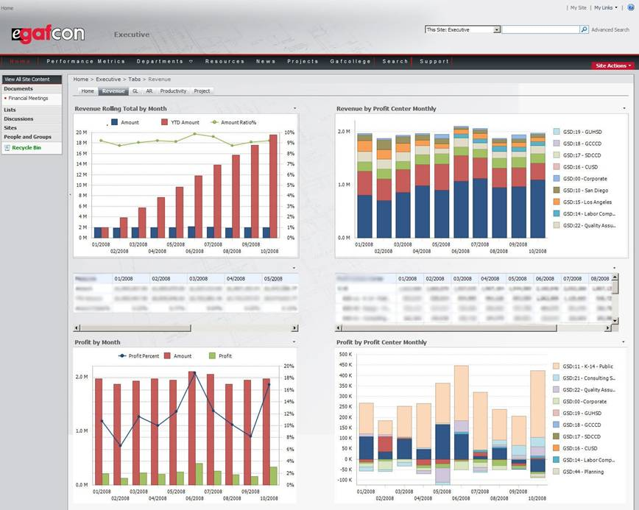
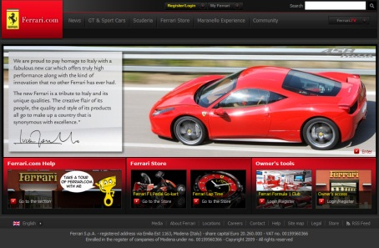

SharePoint Sites
> Engage People Across Your Value Chain Using One Platform
Customers
Employees
Partners
Internet
Intranet
Extranet
Publishing standards
(XML, XHTML…)
Accessibility standards
(WCAG 2.0)
Notes:
11

Slide 12
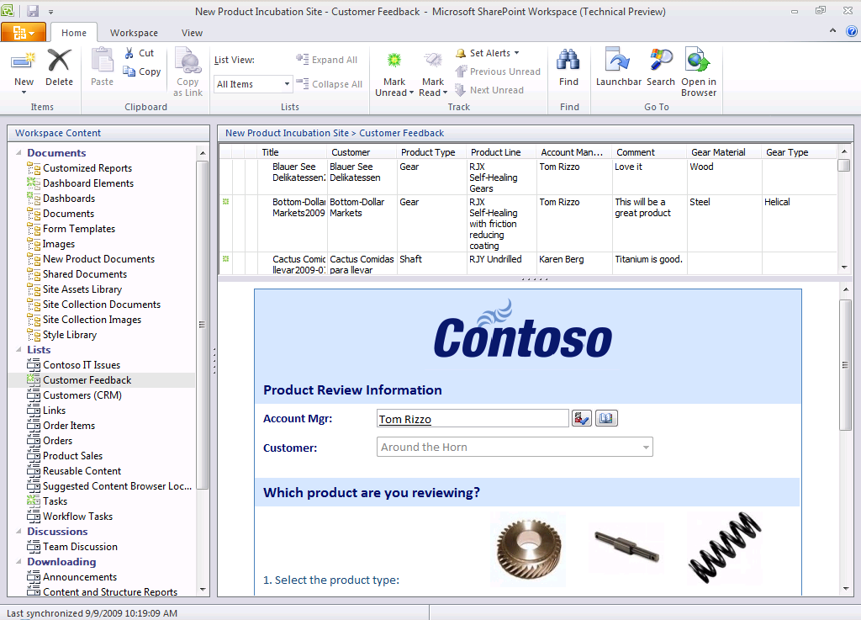
SharePoint Sites
> Taking Entire Sites Offline with SharePoint Workspace
Ribbon UI
Synchronizing changes,
not entire files
Custom Lists
LOB Data
Rich and native integration with InfoPath Forms
Pre-Beta screenshots, subject to change

Slide 13
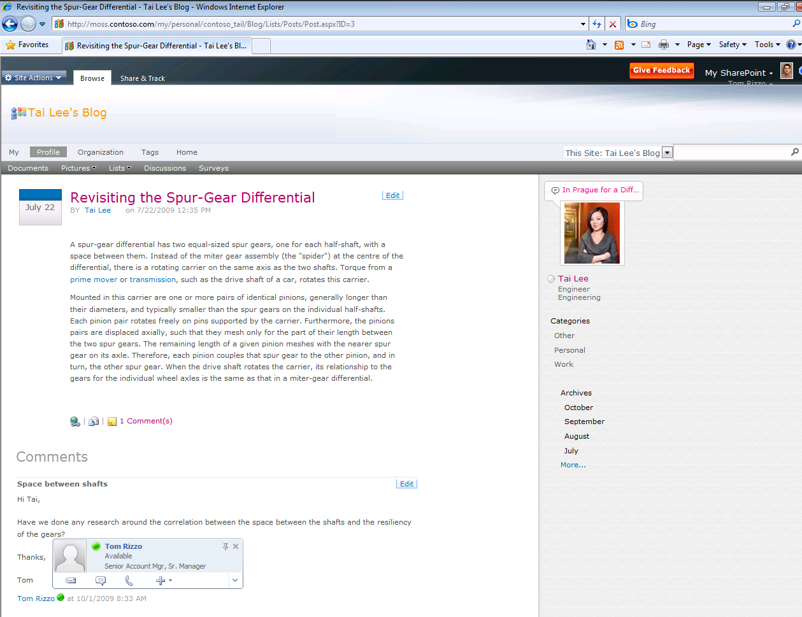
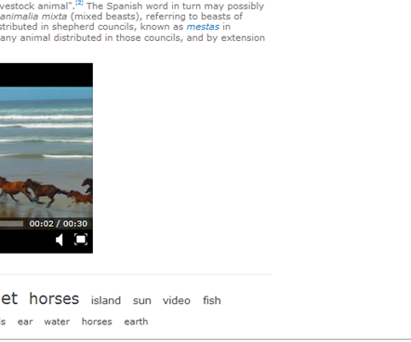
Create community knowledge with Wikis & Blogs
SharePoint Communities
Rich blogging experience
Content rating
Comments and presence
Rich media embedded
Tag-cloud navigation
Pre-Beta screenshots, subject to change

Slide 14
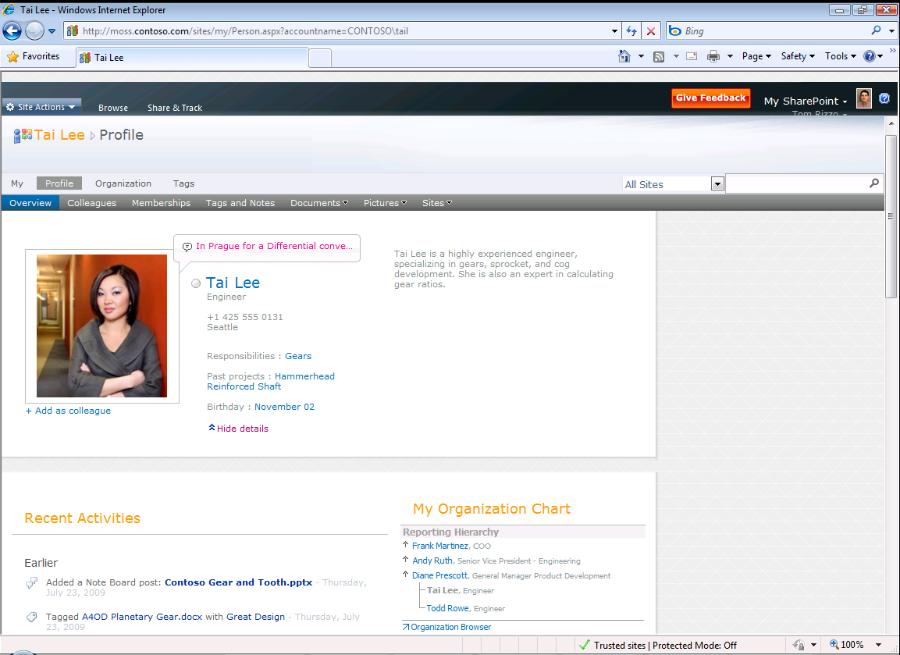
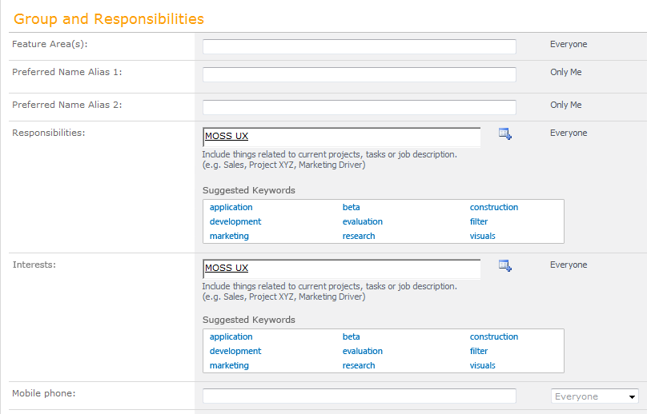
Use My Site to share your interests, responsibilities and activities
SharePoint Communities
Define responsibilities or interests with tags
Interests
Activities
Pre-Beta screenshots, subject to change

Slide 15
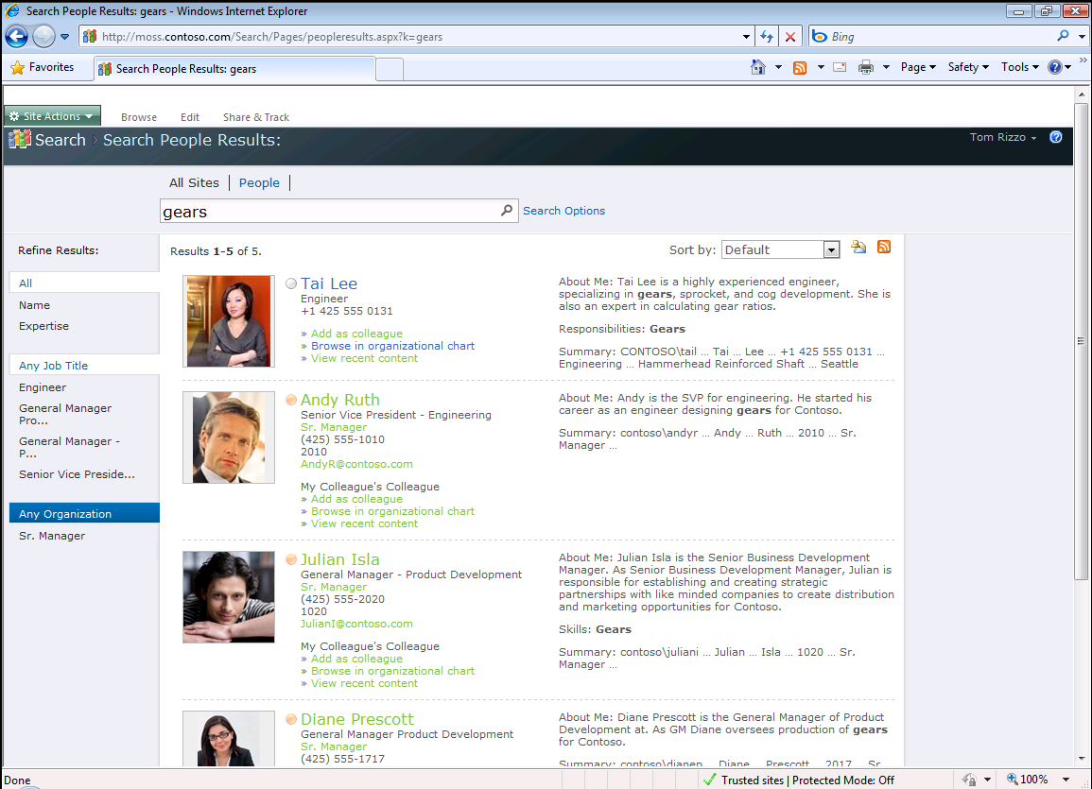
Easily Find Expertise with People Search
SharePoint Communities
Search by expertise and profile
Search by Expertise and Profile
Pre-Beta screenshots, subject to change

Slide 16
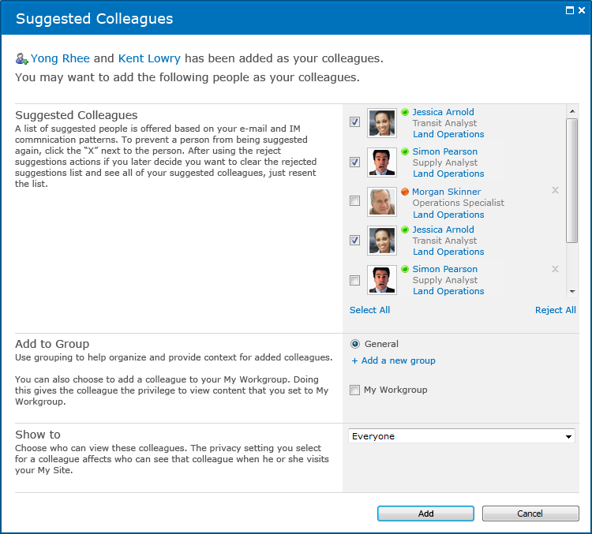
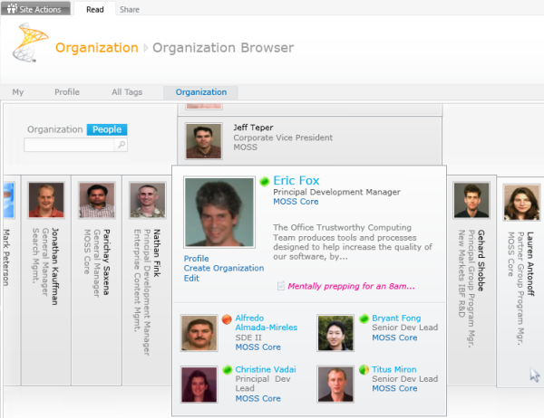
Easily Build & Access your Business Community
SharePoint Communities
Define your colleagues
Browse People directory
Pre-Beta screenshots, subject to change

Slide 17
SharePoint Content
User-centric
Intuitive interaction with content through Office
Fast discovery using content metadata and tagging
Rapid creation and publishing of web content
Flexibility and Compliance
Pervasive records management and legal holds
Enterprise-wide taxonomies and folksonomies
Cross-farm policies and rules for all content types
Management Efficiency
Metadata and tagging managed by same services
Less storage and bandwidth for Office & binary content
Interoperability framework to link legacy repositories

Slide 18
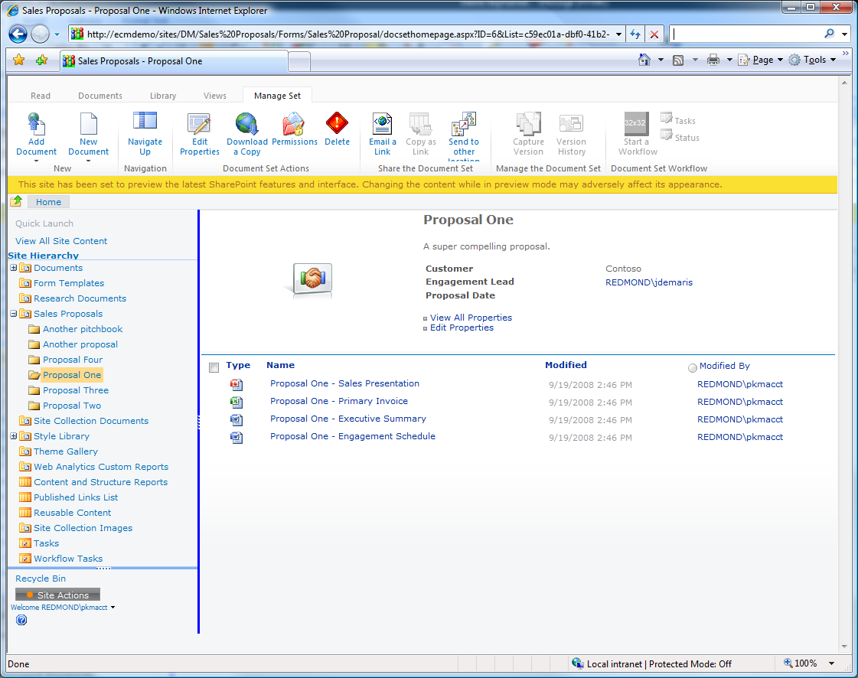
SharePoint Content
> Enable Employees to Deliver Value Fast with Document Sets
Managed as a single entity
Different types of content items
Pre-Beta screenshots, subject to change

Slide 19
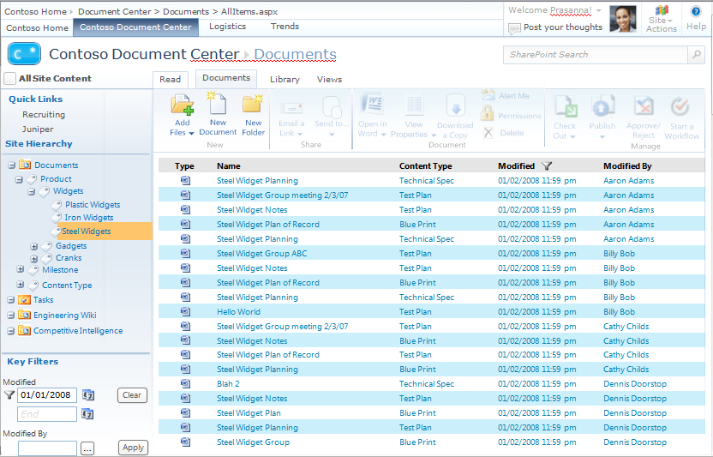
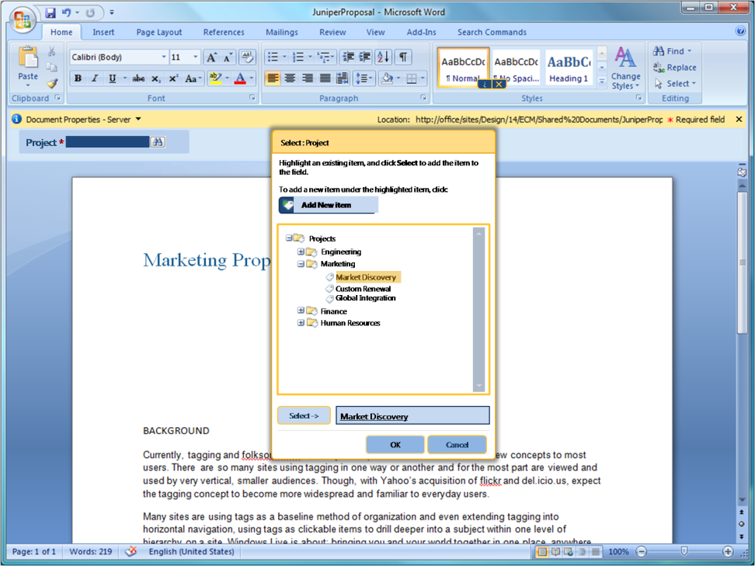
SharePoint Content
> Make it Easy for Users to Enter Metadata and Use it
Metadata-driven
Navigation
Capture Metadata in Office
Hierarchical Taxonomy Structure
Pre-Beta screenshots, subject to change

Slide 20
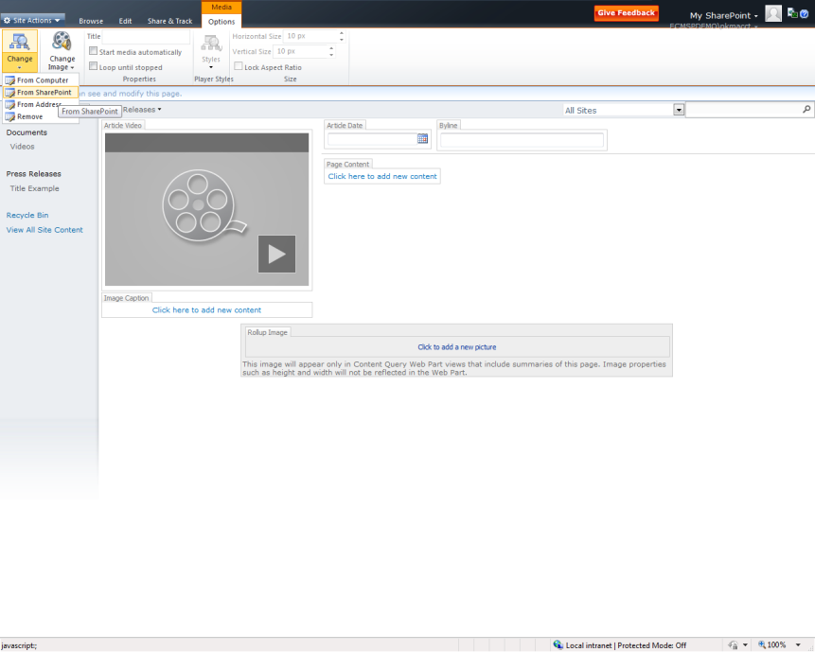
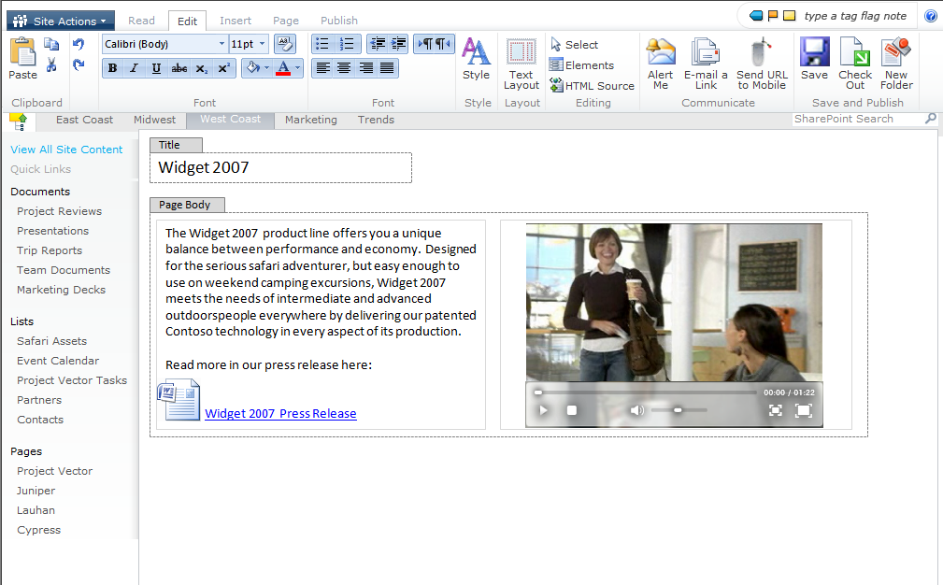
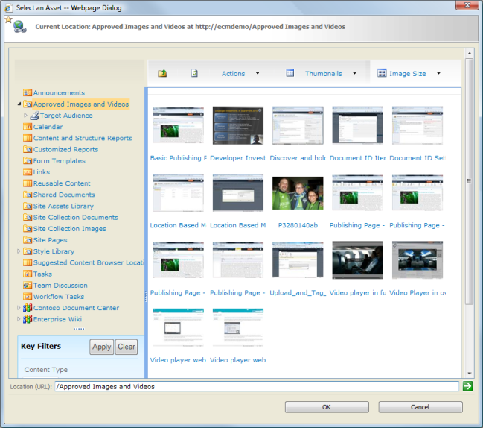
SharePoint Content
> Rich Authoring & Publishing for Web & Multi-media Content
Ribbon Menu for Media Content
Streaming Video on Web Pages
Microsoft Confidential, Prototype Only
Digital-Asset Management
Pre-Beta screenshots, subject to change

Slide 21
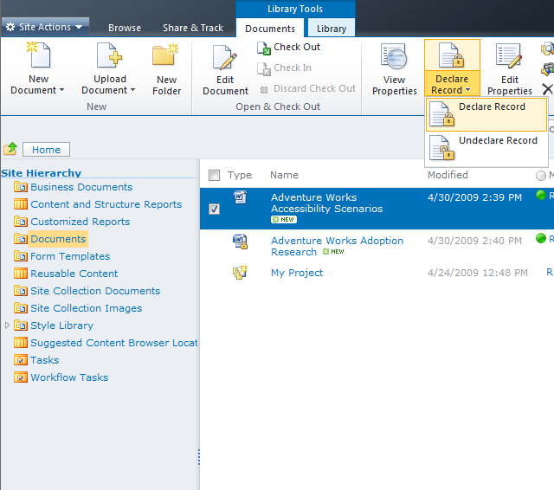
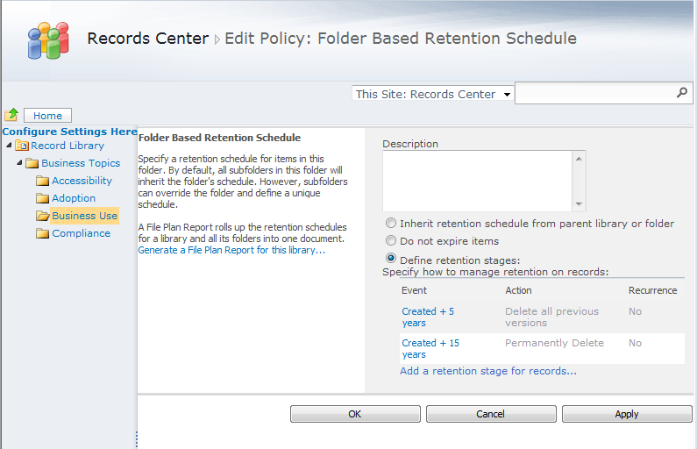
SharePoint Content
> Expand Reach of Records Management Across the Enterprise
Declare a Record in a Team Site
Multi-Stage Disposition Policies
Location-based Policies
Pre-Beta screenshots, subject to change

Slide 22
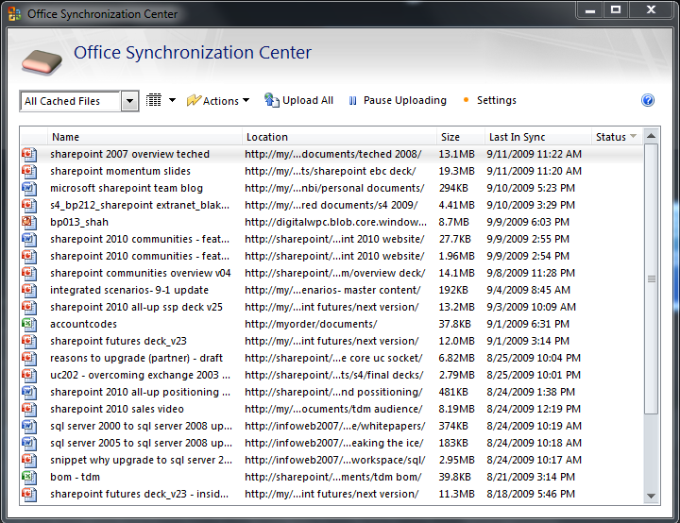
SharePoint Content
> Reduce Network-related Costs with Locally Cached Content
Local Copy Saved for Offline Access
Synchronizing Only Updated Sections (Deltas)
Editing Conflict Resolved by Merge Engine
Pre-Beta screenshots, subject to change

Slide 23
Microsoft SharePoint 2010
> The Business Collaboration Platform for the Enterprise & the Web
Sites
Connect and Empower People
Composites
Communities
Cut Costs with a Unified Infrastructure
Insights
Content
Rapidly Respond to Business Needs
Search

Slide 24

©2009 Microsoft, Microsoft Dynamics, the Office logo, and Your potential. Our passion. are trademarks of the Microsoft group of companies. The information herein is for informational purposes only and represents the current view of Microsoft Corporation as of the date of this presentation. Because Microsoft must respond to changing market conditions, it should not be interpreted to be a commitment on the part of Microsoft, and Microsoft cannot guarantee the accuracy of any information provided after the date of this presentation. MICROSOFT MAKES NO WARRANTIES, EXPRESS, IMPLIED OR STATUTORY, AS TO THE INFORMATION IN THIS PRESENTATION.

Slide 25
“Wave 2010” is not just
the best productivity experience across the pc, phone and browser,
it is also a cost effective, manageable way for IT to deliver that experience across the
whole organization

Slide 26
The Best Productivity Experience Across the PC, Phone & Browser
Notes:
April 8-9 2004
26

Slide 27
Let’s watch a demo...

Slide 28
Let’s watch a demo...

Slide 29
SharePoint Search
Better Answers, Faster
Improved relevance based on usage and history
Rich results-navigators for shorter search time
Support for 400+ content types and 85 languages
Phonetic and multi-lingual for global relevance
Social connections driven by interests and expertise
Secure access to content, whether internal or external
Knowledge Amplification
Enterprise Deployment
Improved scale to meet any demand volume
Deployment-specific tuning for best results
Search-driven applications to enrich platform

Slide 30
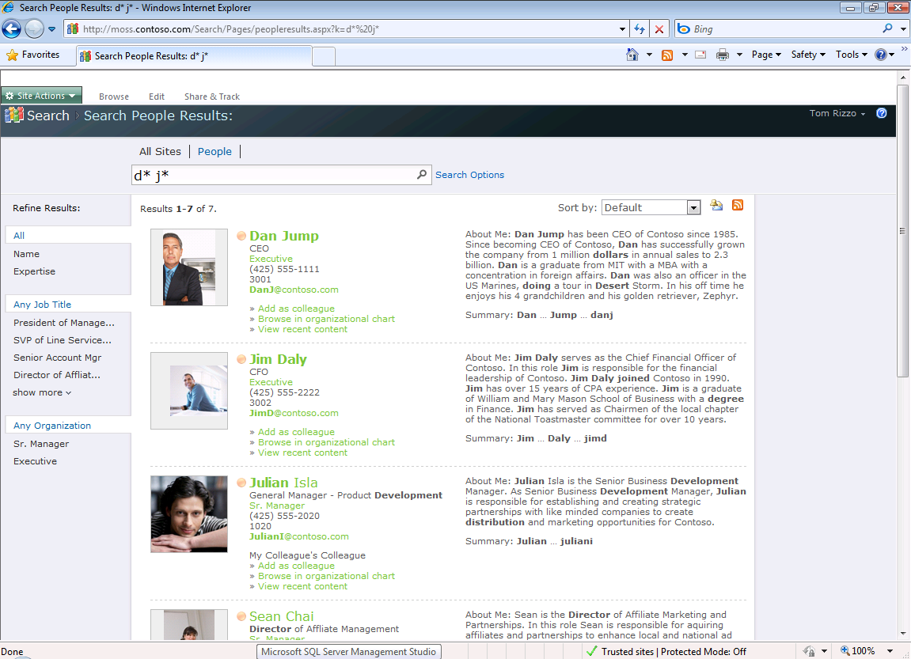
SharePoint Search
> Designed for a Collaboration Platform
Supports Phonetic Name Lookup & Wildcards
Organization Browsing
Filter by Focus, Expertise, etc
Recent
Content
Pre-Beta screenshots, subject to change

Slide 31
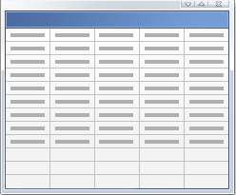


FAST Plugs in to SharePoint Server
Content search
FAST Search
for SharePoint
Content search
+
SharePoint Server
SharePoint Server
People search
People search
End
Users
End
Users
Content +
Profiles
Content +
Profiles
Unique for Content vs. People
Query
Indexing
Content processing
Common Front End
UI Framework
Query OM
Federation OM
Common Back End
Crawling
Connectors

Slide 32
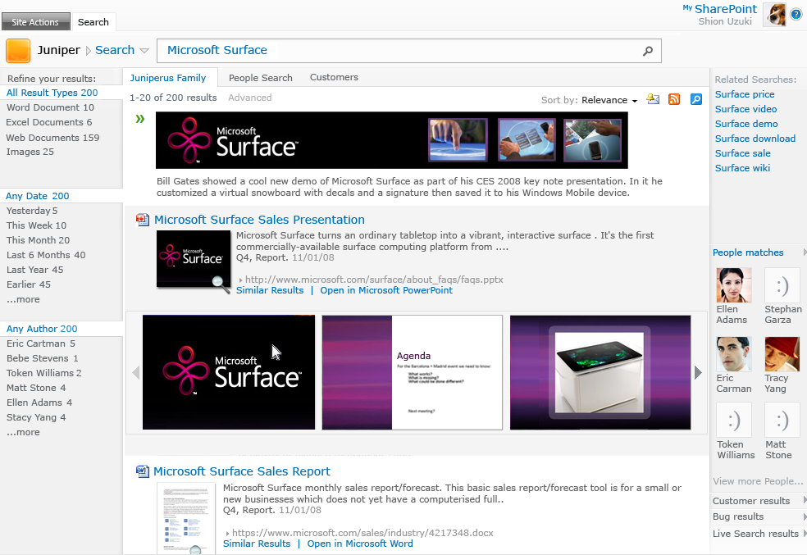

SharePoint Search
> Conversational Search that Understands Your Information
Relevance Enhanced by User Tagging & Rating
Featured Content
Related Searches
Navigators with Exact Counts
Document Previews
Document Thumbnails
Pre-Beta screenshots, subject to change

Slide 33
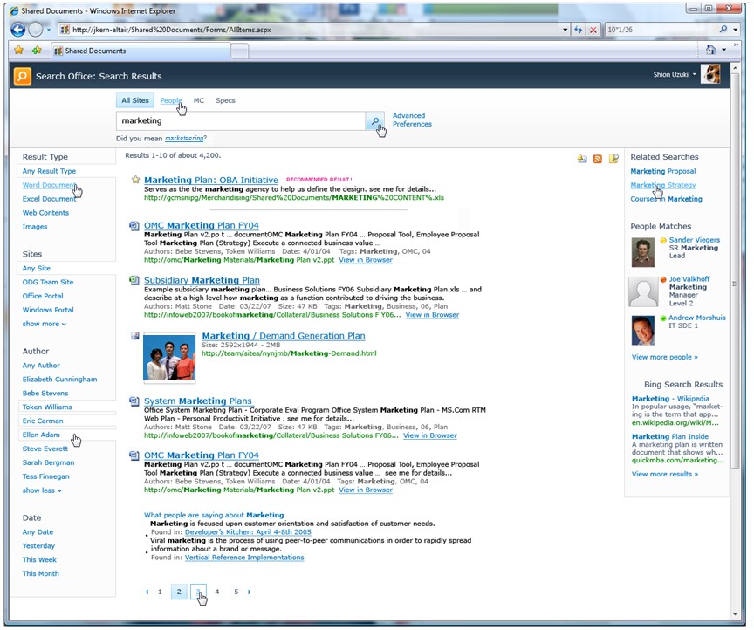
Great Search Experience OOB
Win7 Connector
Get more relevant results
through a search center with hit highlighting, results summaries, related queries, and enhanced query syntax
Related searches
Best Bet
Find information faster
with metadata-driven refinement, query suggestions, search scopes, and federated results which help pinpoint information
Launch in Office Web Apps
Search from anywhere
Including mobile and desktop integration; Office Web Apps speed access to results; enhancements for multi-lingual
Federated results
Refinement panel

Slide 34
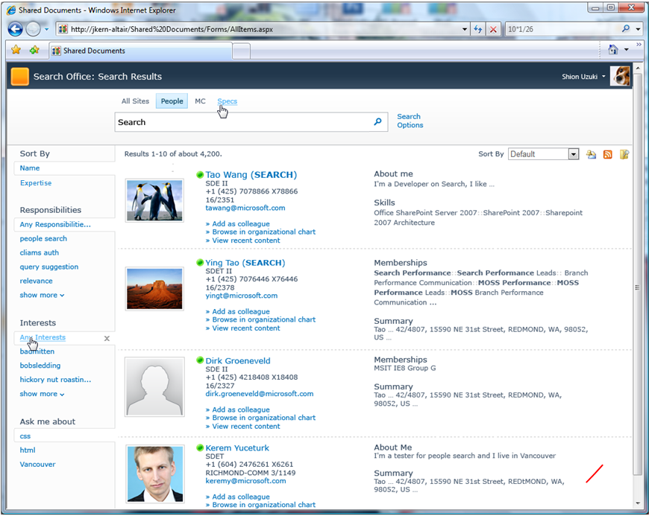
Search is Social
Connect with expertise
using improved matching from
mined Outlook inbox data and
SharePoint MySite profiles
Refine by focus, expertise, and other attributes
Phonetic and nickname matching
Presence
Improve relevance with use
based on how people tag content in SharePoint and on click-through of search results
Expertise identification
Find people
through nickname and phonetic matching, people specific refinement, tuned relevance models
Recently authored content

Slide 35

Search Technology Concepts
Concepts
Search Center - UI for users to issue queries and interact with results
Query Object Model
OpenSearch Source
Query Servers - Accept query requests from users and return results
Query Servers
Query Federation - Return results from non-SharePoint Indexes
Index Partition
Indexing - Extract information from items to enable efficient matching
Indexer
Index Partition - Subset of the overall index
Crawling - Traverse URL space to record items in search catalog
Scaling
Crawler
Connectors - Know how to process different content sources
Content Sources - Host the content we want to return in main results
Content
Content
Content

Slide 36
SharePoint Server 2010 Search
Major improvements over MOSS 2007
Area | New features and benefits | MOSS 2007 | SharePoint 2010
Social | Connect with people and expertise Address-book style name lookup with phonetic matching Improved expertise matching - mined e-mail inbox data Social behavior improves search; search improves mySites | ✰ | 
Refinement | Find information faster Metadata-based refiners provide drill-down Related query suggestions show popular queries |  | 
Relevance | Provide great search results New ingredients, more experience -> better OOB search Better wordbreakers in more languages Social Distance, tagging, click-through influence relevance | ✰ | 
Platform | Industrial Strength Search at High Scale Index partitioning -> sub-second latency at 100M items Full failover support Connector and BDC enhancements and tooling support | ✰ | 
TCO | Deploy and Operate with less effort Virtualization and native 64-bit simplify deployment Powershell, Admin Web Parts, SCOM provide easier admin | ✰ | 
Extensibility | Create powerful applications based on search Web parts, query OMs are public -> easy to modify Enhanced query syntax | ✰ | 

Slide 37
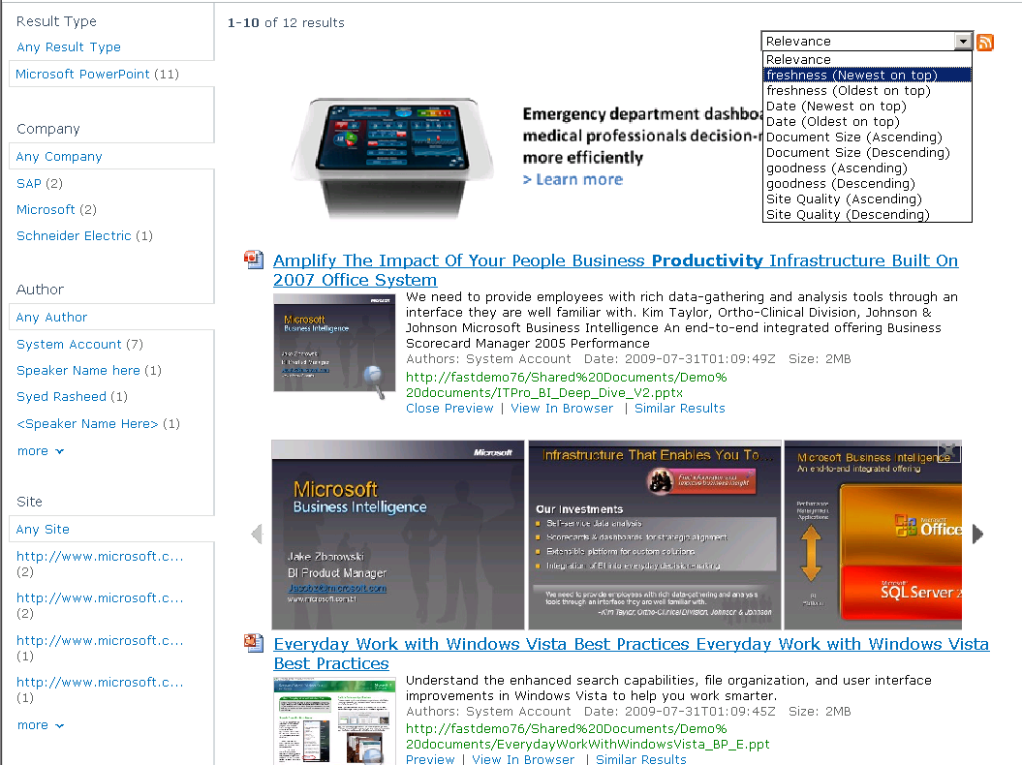
Go Beyond the Search Box
Sorting on any property
Visual, Conversational Search
Visual Best Bets
Scrolling PowerPoint
Previews
Refinement with counts
on any property
Thumbnails
Promote / Demote Results
Similarity Search

Slide 38


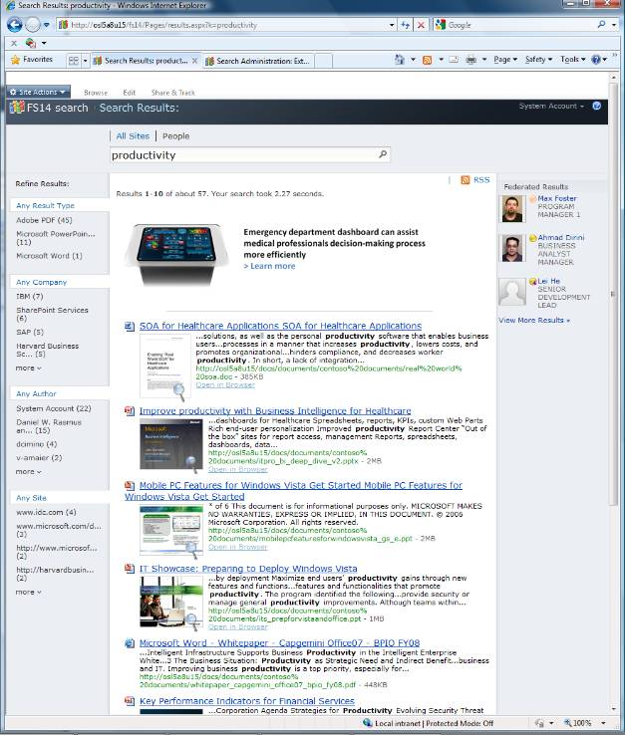
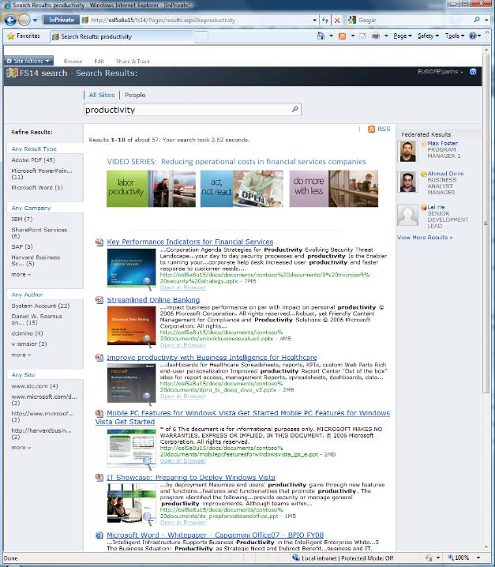
User Context Matters
Kevin Kennedy
Healthcare Sales
”What’s the latest product news for productivity”
Alan Brewer
Financial Services Sales
”What’s the latest product news for productivity”

Slide 39
Go Beyond the Search Box
Broader, Better Language Coverage
Can search in any language
84 languages detected to allow language-specific handling
45 languages with advanced linguistics features
Afrikaans | Hausa | Pashto, Pushto
Albanian | Hebrew | Persian
Arabic | Hindi | Polish
Armenian | Hungarian | Portuguese
Azerbaijani | Icelandic | Punjabi
Basque | Indonesian | Rhaeto-Romance
Bengali,Bangla | Irish | Romanian
Bosnian | Italian | Russian
Breton | Japanese | Sami (Northern)
Bulgarian | Kannada | Serbian
Catalan | Kazakh | Slovak
Chinese-S | Kirghiz | Slovenian
Chinese-T | Korean | Sorbian
Croatian, | Kurdish | Spanish
Czech | Latin | Swahili
Danish | Latvian, Lettish | Swedish
Dutch | Letzeburgesch | Tagalog
English | Lithuanian | Tamil
Estonian | Macedonian | Telugu
Faroese | Malay | Thai
Finnish | Malayalam | Turkish
French | Maltese | Ukrainian
Galician | Maori | Urdu
Georgian | Marathi | Uzbek
German | Mongolian | Vietnamese
Greek | Norwegian | Welsh
Greenlandic | Norwegian-B | Yiddish
Gujarati | Norwegian-N | Zulu

Slide 40

Why is FAST Smarter?
The Content Pipeline
Processing & refinement
Strong linguistic coverage
  84 languages detected
  45 languages with advanced linguistics features
  Spell checking & synonyms improve search experience
  Lemmatization on content side for higher precision and recall
  Unique offensive content filtering
Configurable content pipeline
  Transform and process content automatically
  Index over 400 document types
Property Extraction creates metadata
  Prebuilt extractors: Person, Location, Company, E-mail, Date, Time
  Generic extractors for extension
Location
REDMOND, Wash., and OSLO, Norway — Jan. 8, 2008
Microsoft Corp. (Nasdaq “MSFT”) today announced that it will make an offer to acquire Fast Search & Transfer ASA (OSE: “FAST”), a leading provider of enterprise search solutions, through a cash tender offer for 19.00 Norwegian kroner (NOK) per share. This offer represents a 42 percent premium to the closing share price on Jan. 4, 2008 (the last trading day prior to this announcement), and values the fully diluted equity of FAST at 6.6 billion NOK (or approximately $1.2 billion U.S. ). FAST’s board of directors has unanimously recommended that its shareholders accept the offer.
Mapper
Company
…
Configurable
Stages
Entity
Extraction
Date
Language
Detection
Format
Conversion
Amount

Slide 41
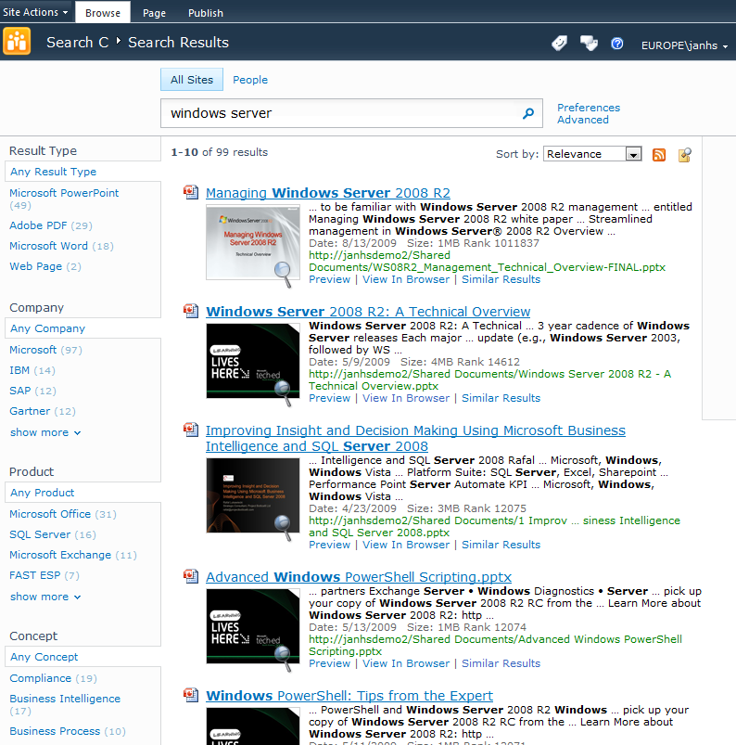

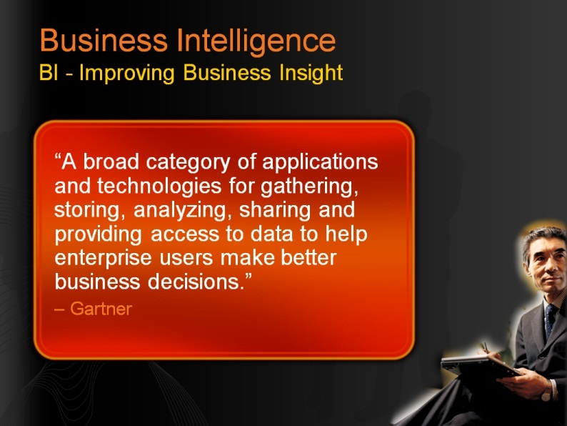
Entity Extraction
PRODUCT (Custom)
CONCEPT (Custom)
COMPANY (OOTB)

Slide 42
FAST Search for SharePoint Topology
Other Search Source
Federated OpenSearch Source
Query/Federation OM
Query Volume
Query Server
Query Server
Query Server
Crawler
Crawler
FAST
Crawler
Crawler
Crawler
Content Volume
Search and Indexing
Content
Content
Content

Slide 43

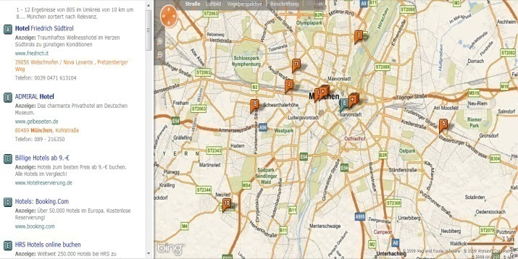

FQL Example : Location Awareness
Geo-search using sortformula()
Content
Processing
Search/Index
Query
Result
External data
ABC
Geo specific processing
Index
Sort results by distance from end-user location
(50,100)
XYZ
123
Geo
Formula sorting allows complete control of distance calculations (standard or ‘warped’ geometries)
Pos_1
Pos_2
Geo data
Lat
Lon
Lat
Lon
Distance(from 50,100) $={\sqrt{{(50−latitude)}^{2}+{(100−longitude)}^{2} } \atop }$
query=hotel&sortby=+[formula:sqrt(pow(50-latitude,2)+pow(100-longitude,2))]

Slide 44
What have we learned today?
End User Perspective
Great OOB search experience
Excellent OOB relevance Federated results Metadata based refiners Query Suggestions, Did You Mean & Related Searches View in browser People search Phonetic & nickname matching Social behavior improves relevance
Most visual and dynamic user experience
Same capabilities, plus: Thumbnails & Previews Visual Best Bets Deep refiners with counts User context from user profile Multiple relevance profiles Sorting on any property Similarity Search Broader, better language support Richer query language

Slide 45
What have we learned today ?
IT Professional Perspective
Enterprise class search system integrated with SharePoint
Enterprise Scale-out (to 100M docs) Full Fault Tolerance Native 64 bit; Hyper-V support Wizard - driven installation Consolidated search dashboard PowerShell support SCOM support Full search reporting Full set of connectors OOB Easy to add new sources via BDC
Highly capable and easy to manage
Same capabilities, plus: Extreme scale-out Content Processing pipeline Entity extraction Tunable relevance ranking Easy setup of User Context, Visual Best Bets, Promotion/ Demotion Easy to configure sorting, and refinement

Slide 46
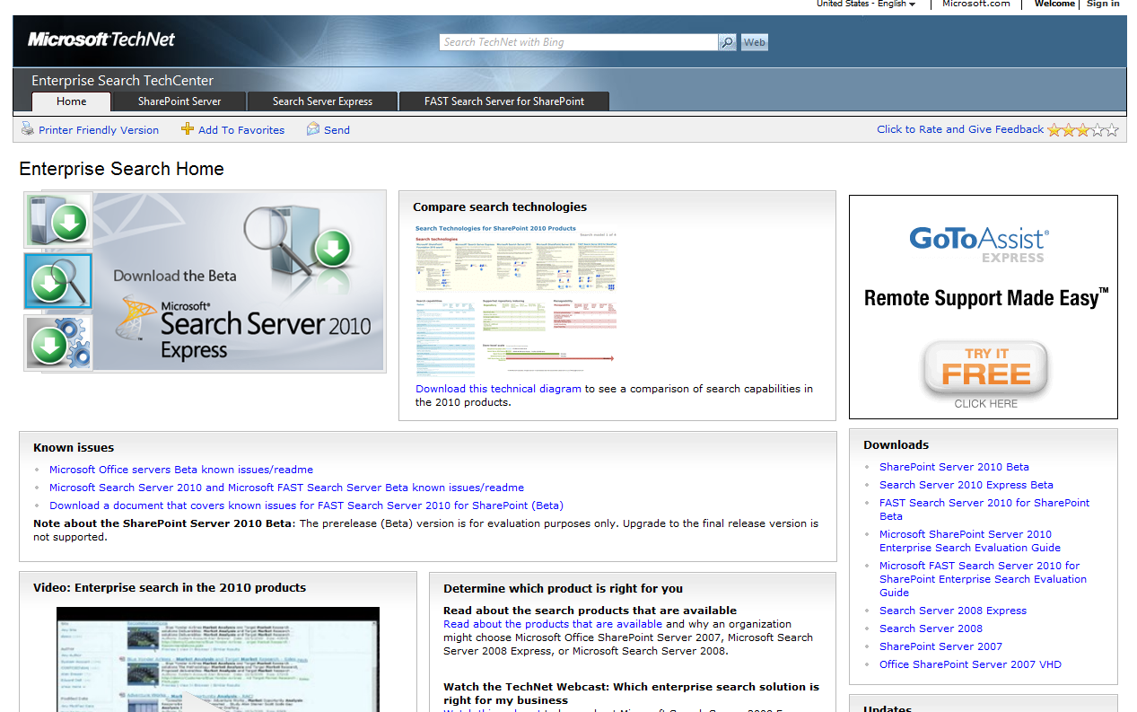
Enterprise Search TechCenter
http://technet.microsoft.com/en-us/enterprisesearch/

Slide 47
SharePoint Insights
Data interaction
Advanced analysis with Excel Services
Richer data visualization and easy sharing
Incorporation of LOB data in data analysis
Powerful Self-Service capabilities and visualizations
Compelling dashboards to drive business results
Rich reports with access to millions of rows
Decision Making
Organizational Effectiveness
Drive accountability and alignment with scorecards
Identify issues and opportunities with real-time access
Improved API for richer extensibility and development

Slide 48
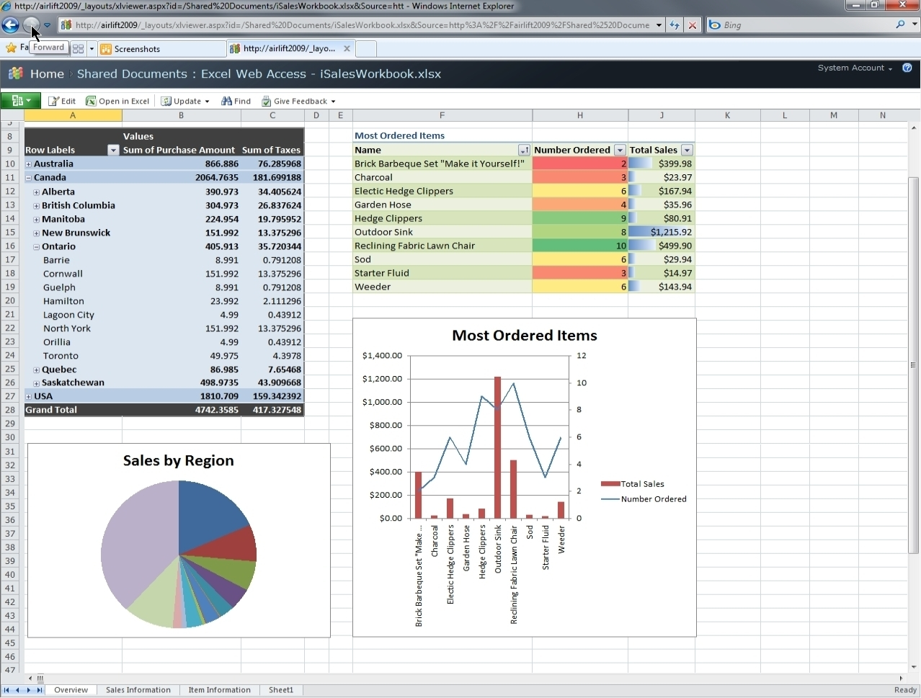
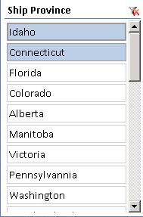
SharePoint Insights
> Effective Data Analysis & Decision-making with Excel Services
Dashboards & Heat Maps
Interactive PivotTables
Data Slicers
Access to Unlimited Data Secured in SharePoint with Gemini Capabilities
Pre-Beta screenshots, subject to change

Slide 49
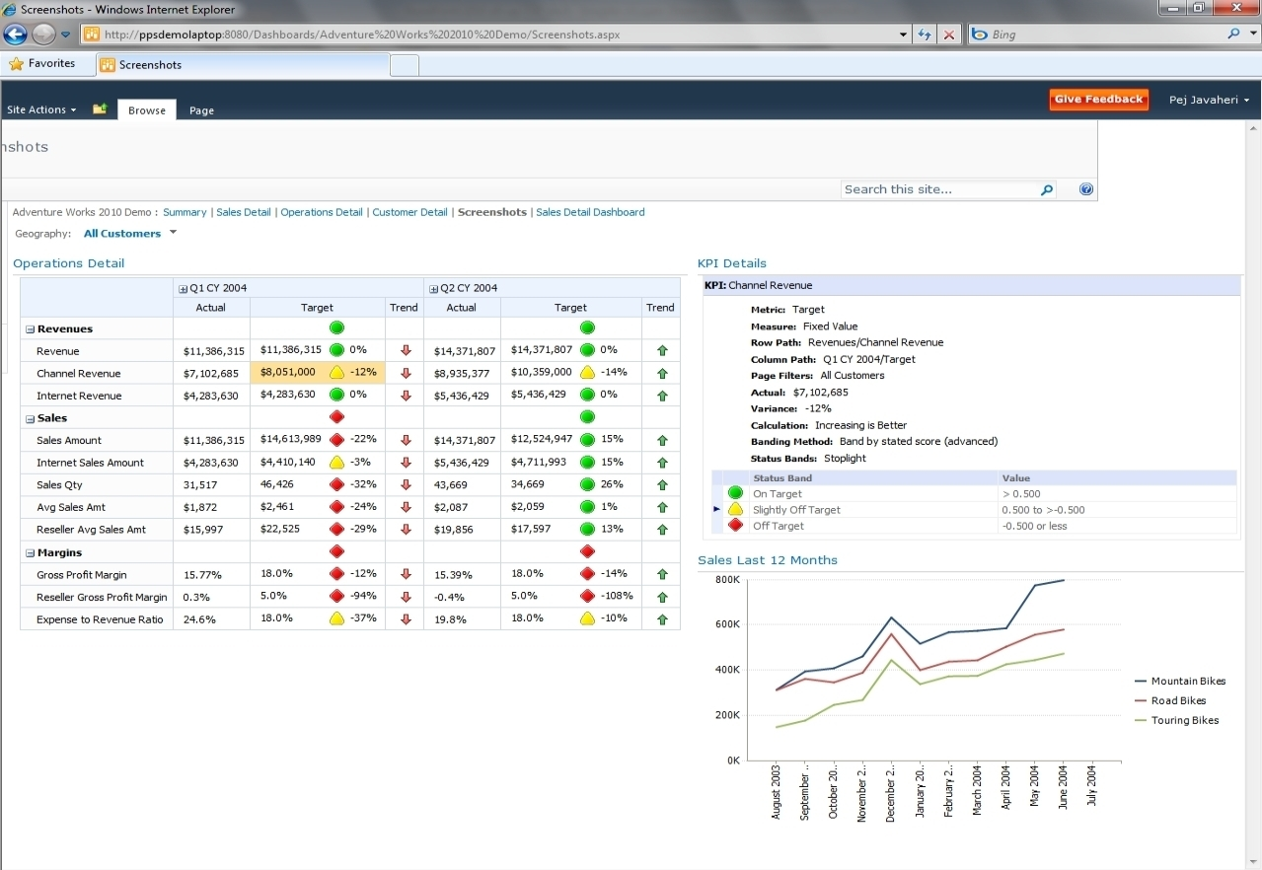
SharePoint Insights
> Enhanced Business Insight with PerformancePoint Services
Visual Scorecards
Detailed KPIs
Integration with SharePoint, including: Administration, Scalability & Deployment
Pre-Beta screenshots, subject to change

Slide 50
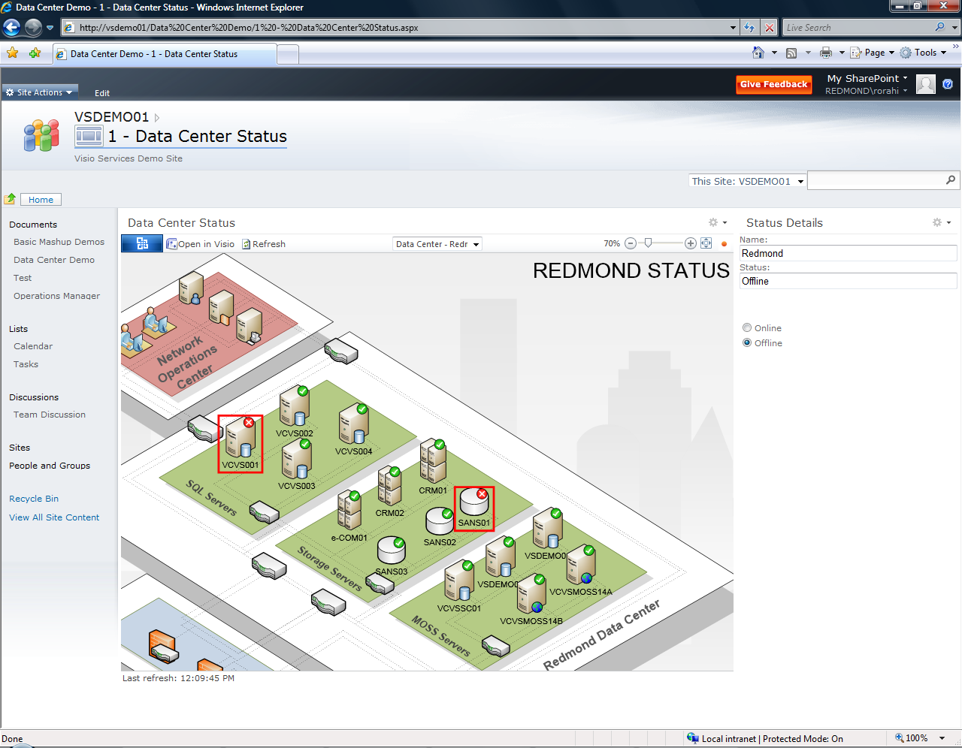
> Visualize Data & Interact with it using Visio Services
SharePoint Insights
Visio Diagrams within a Browser
Real-time, Visual data
User Interaction with Shapes, Graphics,
and Hyperlinks
Real-time Updates with Connectivity to any Data Source
Pre-Beta screenshots, subject to change

Slide 51
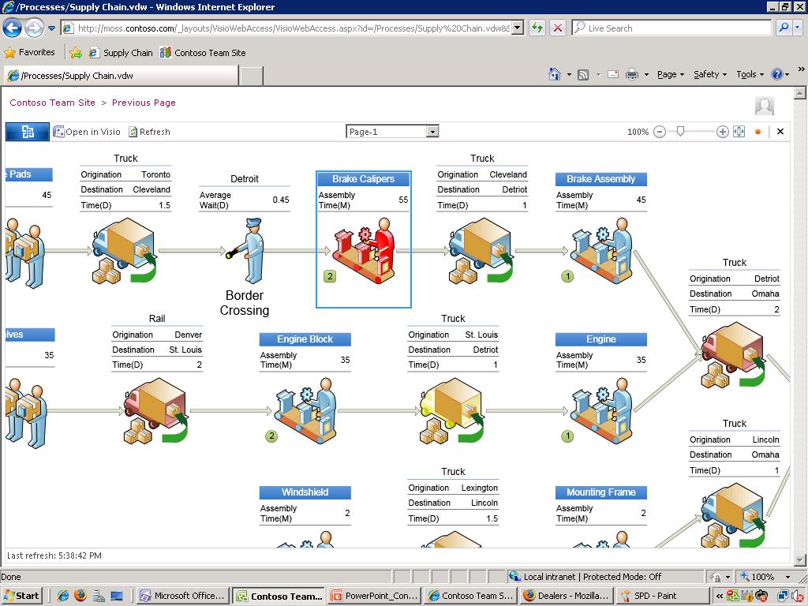
Visio Services
> Another Screenshot

Slide 52
SharePoint Composites
Enhanced toolset for end-user solutions
Process automation and data validation with Forms
Visio services integration for data visualization
User-Driven Solutions
Data Connectivity
Business Connectivity Services for LOB data exchange
LOB data in Outlook, Word & Workspace without code
SharePoint data exposed through web services & APIs
Solution Deployment
Sandboxed Solutions for self-service and fast installation
Platform stability with resource quota-management
Standards support for integration and accessibility

Slide 53
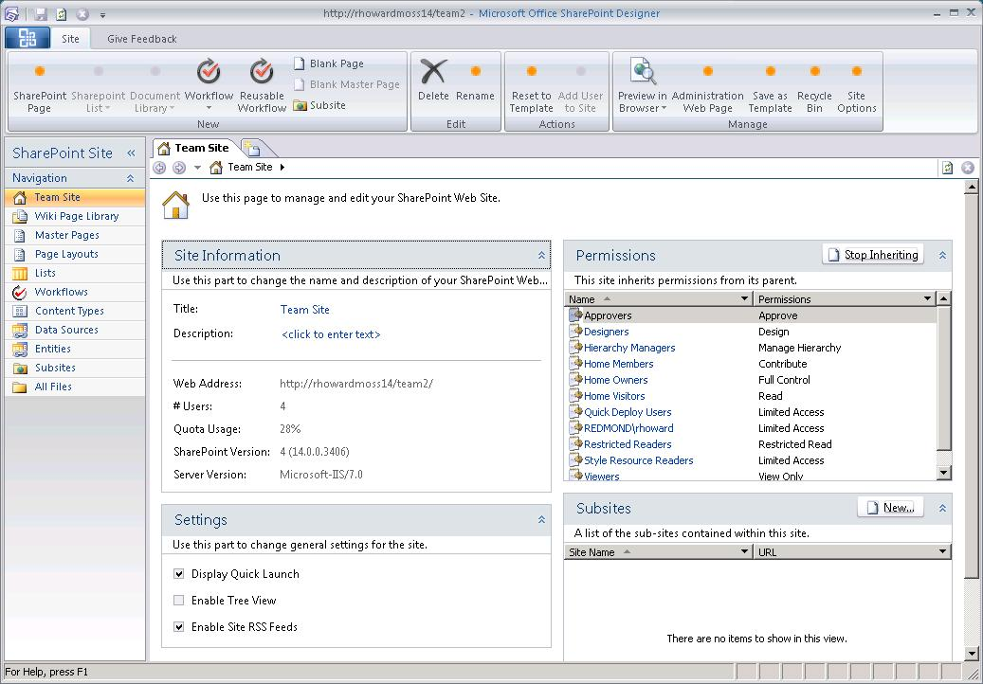
> Easily Build Solutions with SharePoint Designer 2010
SharePoint Composites
Page Editor
Ribbon UI
Workflow Designer
External Data
Pre-Beta screenshots, subject to change

Slide 54
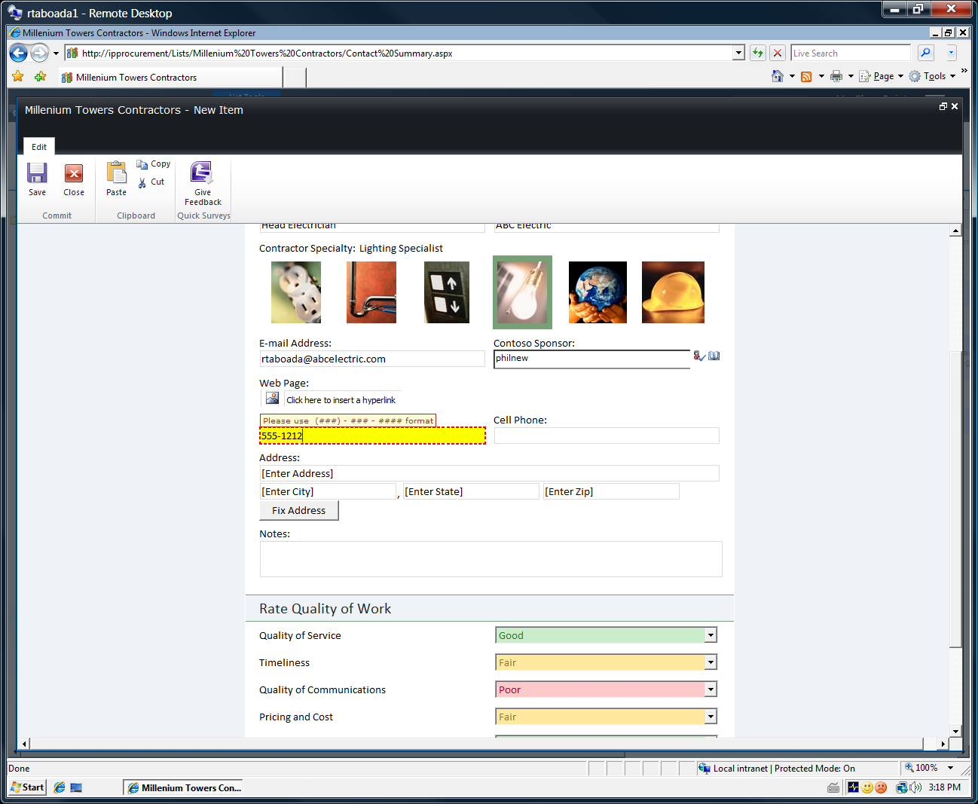
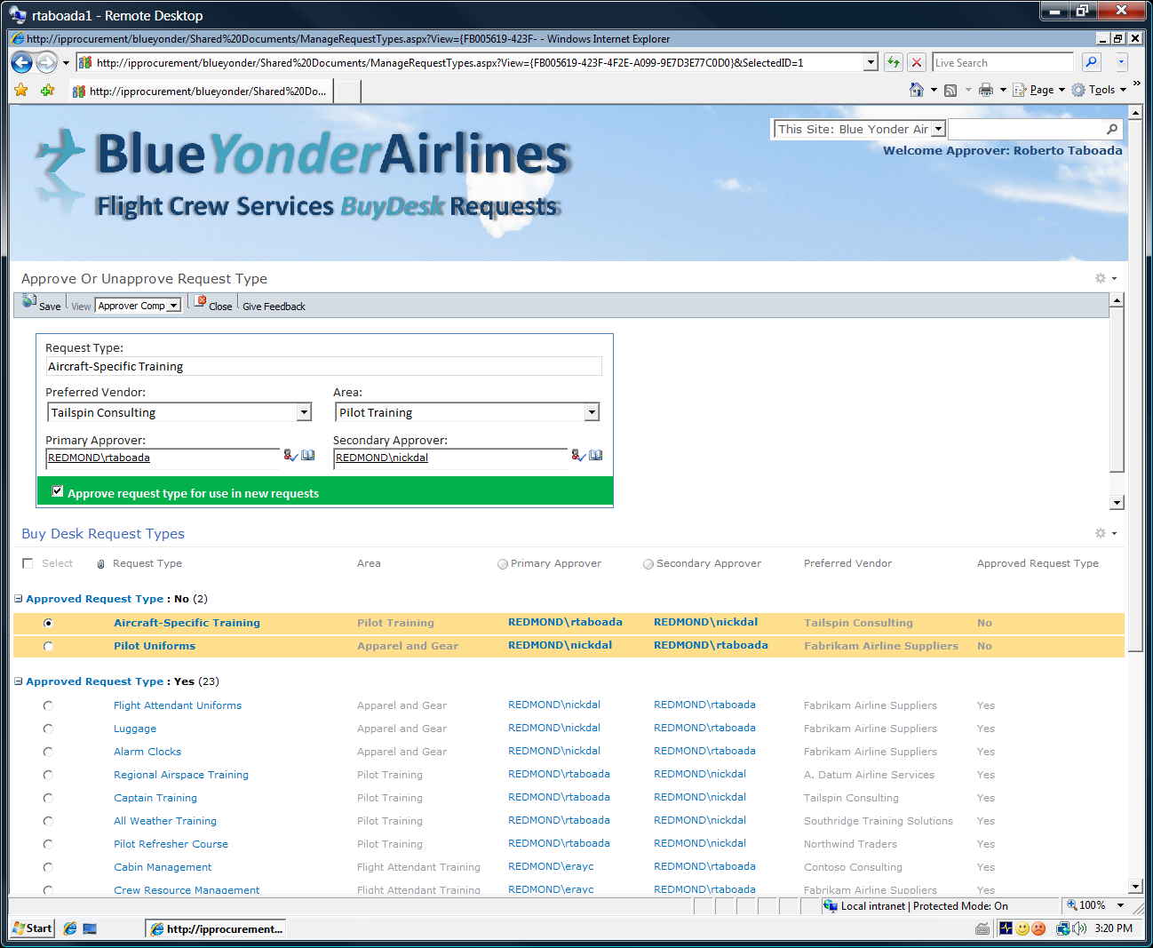
> Robust Process Automation with InfoPath Forms
SharePoint Composites
Rich Formatting & User Experience
Data Validation
InfoPath Web Part
Pre-Beta screenshots, subject to change

Slide 55
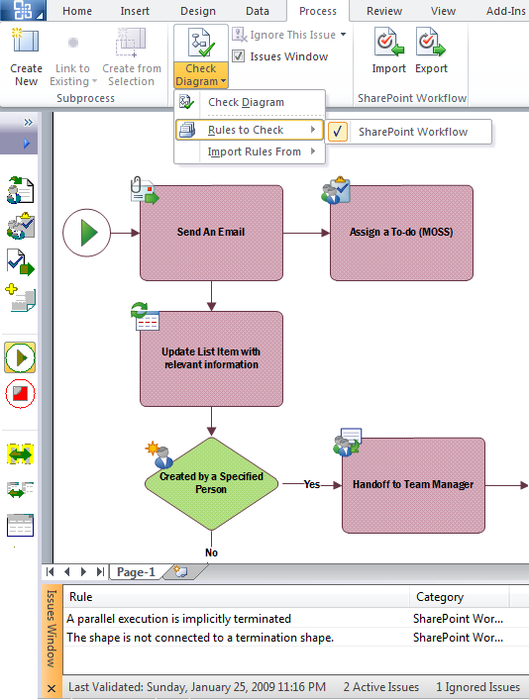
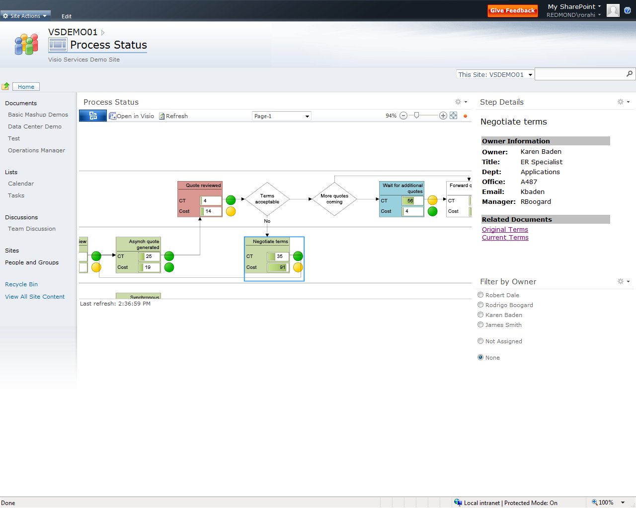

> Enhance Out-of-box Functionality with Visio & Visio Services
SharePoint Composites
Design Workflow
in Visio
Publish & Use in SharePoint
Improve with SPD
Pre-Beta screenshots, subject to change

Slide 56


Governable Self-service Deployment with Sand Boxed Solutions
SharePoint Composites
Web-part Deployment
What can be deployed?
Web Parts
Event Receivers
Feature Activation Receivers
Workflow Actions
InfoPath Forms
Site and List Templates
Resource-quota Management
Restricted to Limited resources
Code CPU Time
SQL Execution Time
Number Exceptions
Custom Code is Isolated
  Separate Process/Server
  Scale Out
Pre-Beta screenshots, subject to change

Slide 57
SharePoint 2010
Enables advanced collaboration scenarios for end users to locate, create, and act on data and documents in disparate sources from within a familiar and unified infrastructure
Excel Services
PerformancePoint Services
Advanced Charting
Visio Services
Access Services
InfoPath Forms Services
Client LOB Integration/
LOB Web Parts
Custom Reports
FAST Search Use Rights*
Portal
Doc/Records Mgmt.
Social Computing
ECM, WCM, RMM
Enterprise Search
Legal Holds, In-Place Rec. Mgmt.
* Requires FAST Search Server 2010 for SharePoint

Slide 58









The SharePoint 2010 Line-Up
Spanning Intranet, Internet, and Extranet scenarios, with specialty servers for Enterprise Search
Intranet
Internet/Extranet
  Enterprise Client Access License (CAL)
  Standard Client Access License (CAL)
New
High-End Search
New
New
New
Enabling Technologies

Slide 59
How to Prepare?
Get Introducted to SharePoint 2010 (online)
  http://sharepoint2010.microsoft.com
Get the Beta here:
  http://sharepoint2010.microsoft.com/try-it/Pages/Trial.aspx
Belgium SharePoint Conference, March 30
  Tech Days Preconference
SharePoint Engineering Blog
  http://blogs.msdn.com/sharepoint/

